Slide 1
Decode Brain Representations based on Python
Zitong Lu
OSU CCBBI Student Workshop
04/21/2023

Slide 2
Why this workshop?
In cognitive neuroscience, multivariate pattern analysis (MVPA) is extensively employed due to its ability to provide richer information compared to traditional univariate analysis.
What do you want to learn through the workshop?
Give an introduction / review?
Introduce some key papers / toolboxes?
…
A Hands-on Tutorial?

Slide 3
Goals of today’s workshop:
1 Know what is the method to decode brain representations
2 Understand why and when to use these methods to decode brain representations
3 Learn how to do brain decoding using these methods
Everyone can do it using minimal code!

Slide 4
Outline of today’s workshop
1 Toolbox + 2 Methods + 3 Coding Examples
Classification-based Decoding
Intro to Classification-based Decoding
Example 1
Example 2
Some extensions of Classification-based Decoding
Representational Similarity Analysis (RSA)
Intro to RSA
Example 3
Some extensions of RSA
NeuroRA
A Toolbox of Representational Analysis
Notes: All examples are based on EEG data today.

Slide 5
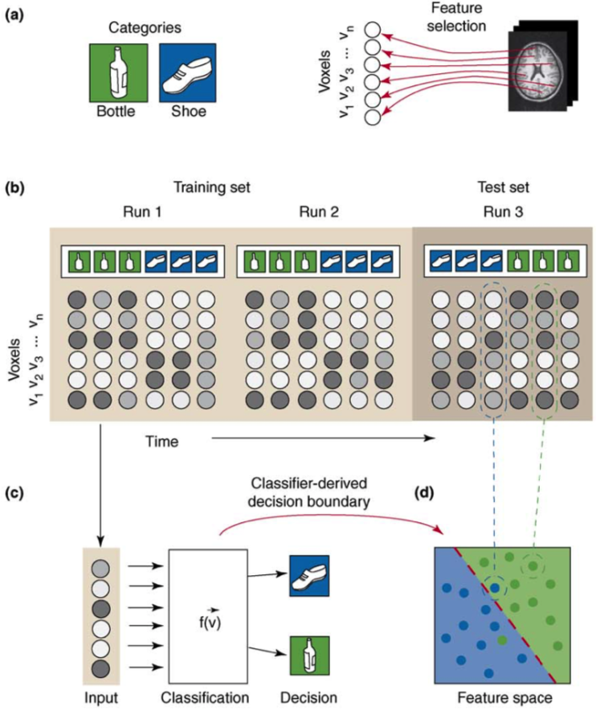
Classification-based Decoding
(Norman et al. , 2016, TICS)

Slide 6

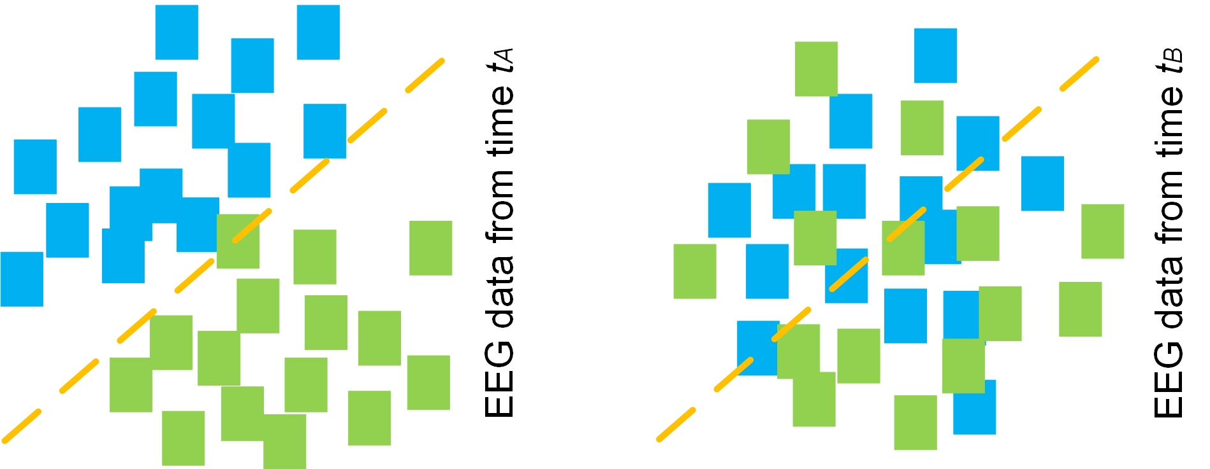


Classification-based Decoding
For EEG
Classification-based decoding
birthday cake vs. boat
Higher classification accuracy
Lower classification accuracy
The representational differences between birthday cake and boat were more strongly encoded at t_{A}

Slide 7
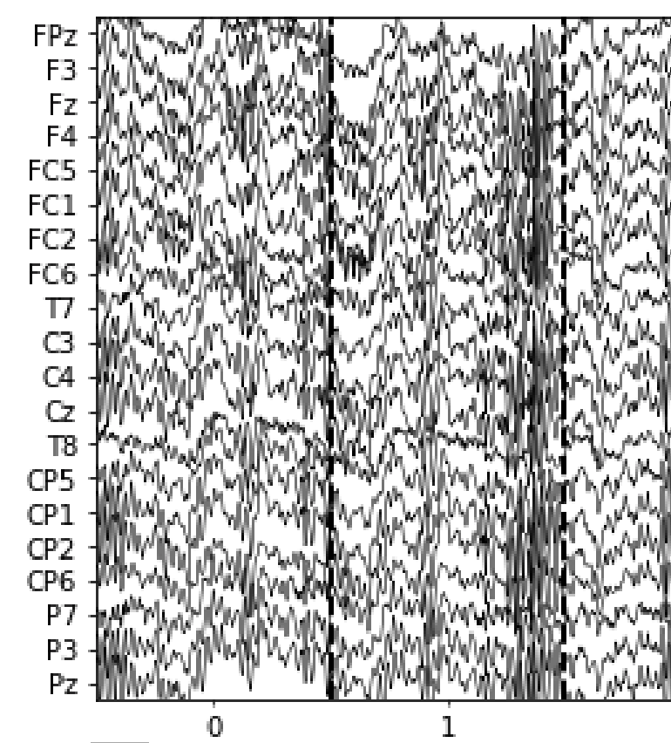
Classification-based Decoding
For EEG
Time-by-time decoding:
to conduct independent classification for each subject and each timepoint using linear classifiers
Data we have:
EEG data:
N_subjects * N_trials * N_channels * N_timepoints
Label data:
N_trials
What should we do:
Classify birthday cake vs. boat for each subject and each timepoint
Use channels as features
Cross-validation for each step
EEG signals for one trial
birthday cake vs. boat
What we want:
Decoding results:
N_subjects * N_timepoints

Slide 8
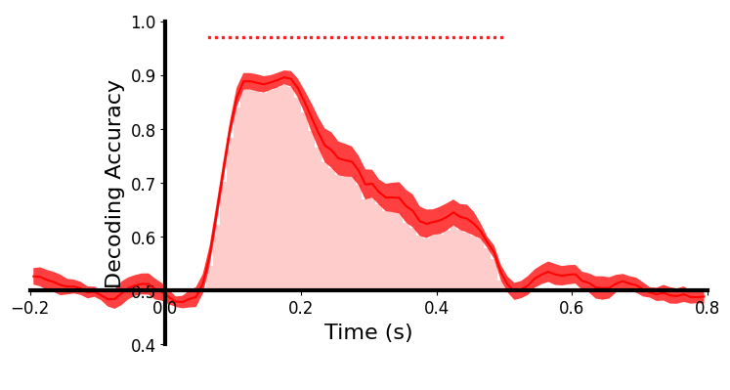
Classification-based Decoding
For EEG
Framework
Data we have:
EEG data:
N_subjects * N_trials * N_channels * N_timepoints
Label data:
N_trials
birthday cake vs. boat
What should we do:
Classify birthday cake vs. boat for each subject and each timepoint
Use channels as features
Cross-validation for each step
What we want:
Decoding results:
N_subjects * N_timepoints

Slide 9
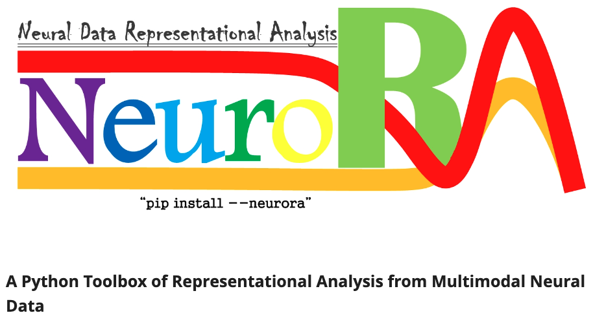
Classification-based Decoding
For EEG
How to do it based on Python?
Framework
Data we have:
EEG data:
N_subjects * N_trials * N_channels * N_timepoints
Label data:
N_trials
What should we do:
Classify birthday cake vs. boat for each subject and each timepoint
Use channels as features
Cross-validation for each step
(Lu and Ku , 2021, FININ)
What we want:
Decoding results:
N_subjects * N_timepoints
NeuroRA provides some very easy-to-use functions.

Slide 10
Classification-based Decoding
Let’s go to the first example !
“Decode image representations”
https://github.com/ZitongLu1996/CCBBI_Decoding_Workshop

Slide 11
Classification-based Decoding
2-class classification -> decode the brain representations of two images
Some experimental designs:
To investigate size representations ->
set small and large objects, and classify small vs. large
To investigate depth representations ->
set font and back objects, and classify font vs. back
To investigate facial expression representations ->
set face images with different expressions, and classify happy vs. neutral vs. sad vs. angry …
To investigate color representations ->
set squares with different colors, and classify red vs. yellow vs. green vs. …
Sometimes, there are more than 2 classes

Slide 12
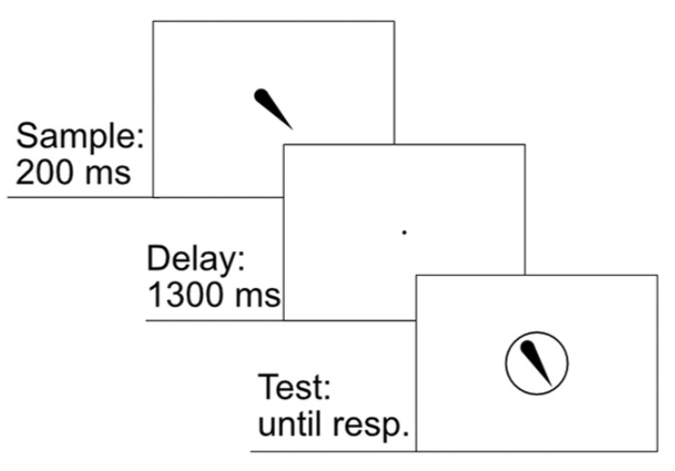
Classification-based Decoding
Sometimes, there are more than 2 classes
To investigate orientation representation,
they set 16 different orientations (0°, 22.5°, 45°, …, 315°, 337.5°).
The only difference between 2-class and 16-class decoding:
Chance level = 50% (1/2) vs. 6.25% (1/16)
(Bae and Luck, JNeuro, 2018)

Slide 13
Classification-based Decoding
Let’s go to the second example !
“Decode orientation representations”

Slide 14
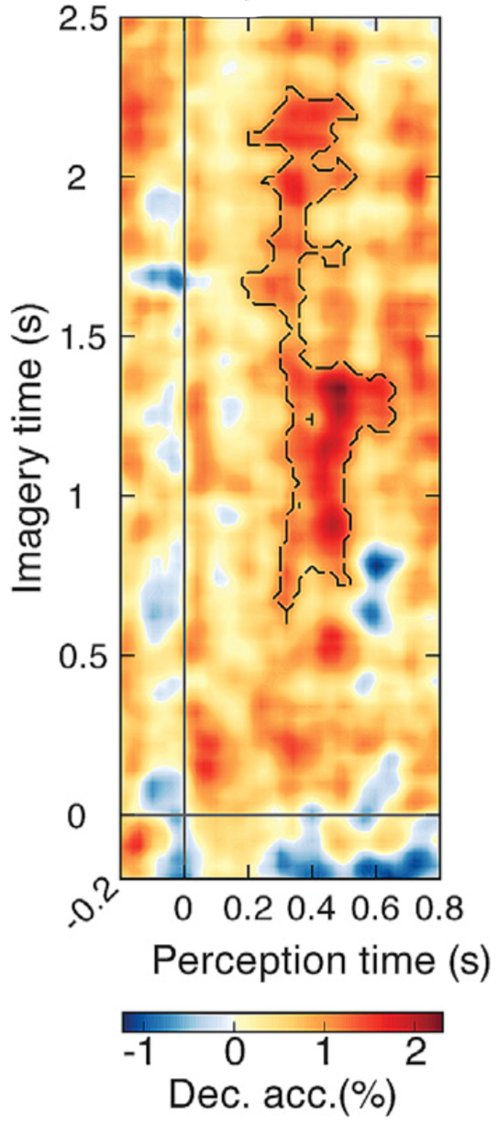
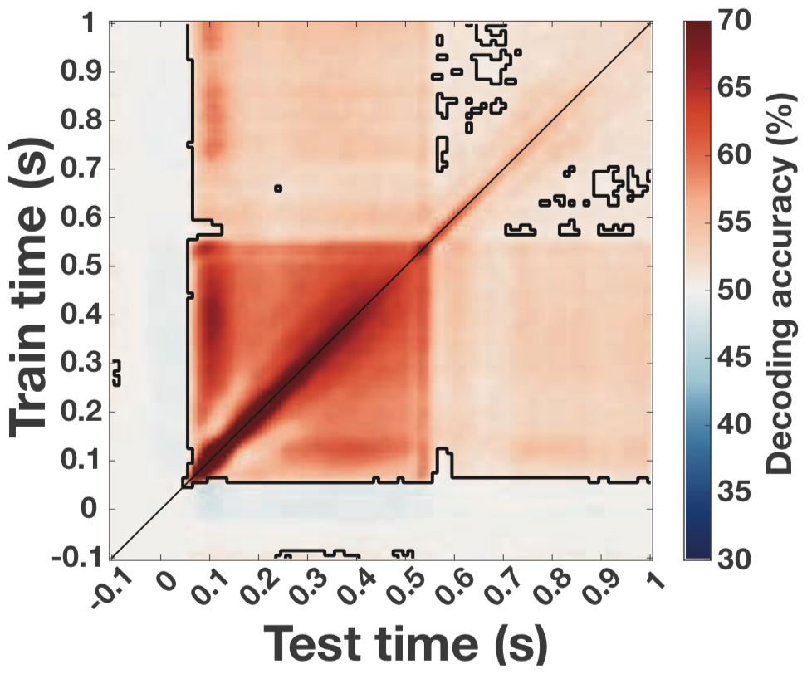
Classification-based Decoding
Cross-task decoding:
Some extensions:
Cross-temporal decoding:
(Xie et al. , 2020, Curr Bio)
(Singer at al. , 2022, JNeuro)
You can find functions corresponding to these extensions in NeuroRA.

Slide 15
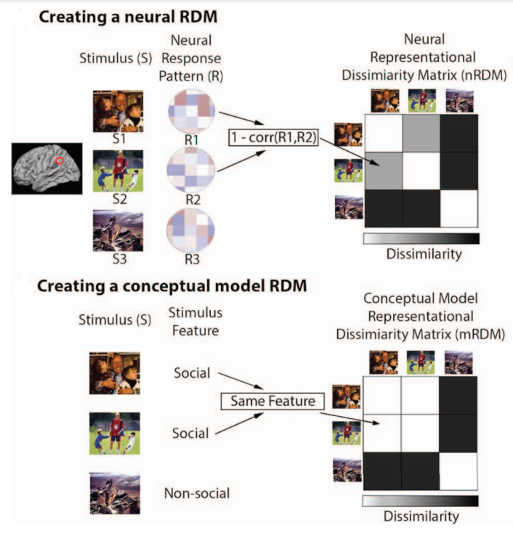
Representational Similarity Analysis
(Popal et al. , 2020, SCAN)

Slide 16
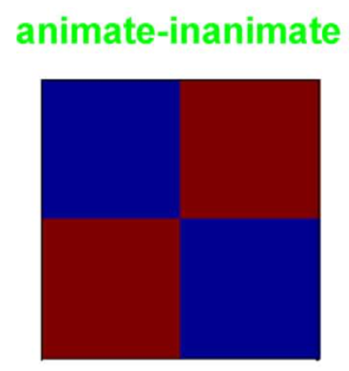
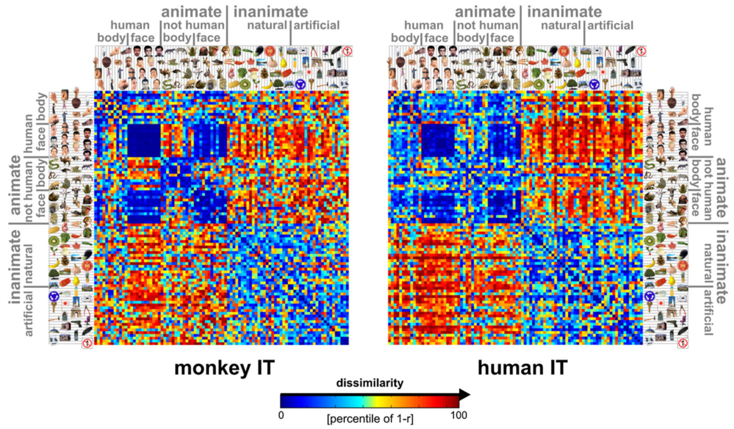
Representational Similarity Analysis
Three steps:
Make hypothesis-based RDM
Make neural RDMs
Compare between hypothesis-based RDM and neural RDMs
(Kriegeskorte et al. , 2008, Neuron)

Slide 17
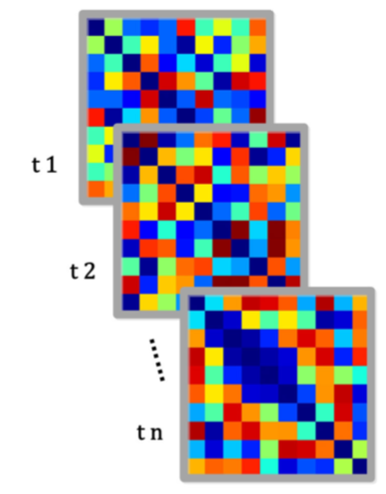
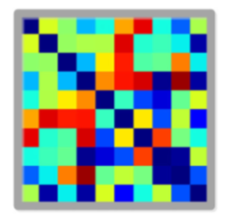
Representational Similarity Analysis
For EEG
Framework
Time-by-time EEG RDMs
Make hypothesis-based RDM
N_conditions * N_conditions
Make neural RDMs
N_subjects * N_timepoints * N_conditions * N_conditions
Compare between hypothesis-based RDM and neural RDMs
N_subjects * N_timepoints
Hypothesis-based RDM

Slide 18
Representational Similarity Analysis
For EEG
Framework
How to do it based on Python?
Make hypothesis-based RDM
N_conditions * N_conditions
Make neural RDMs
N_subjects * N_timepoints * N_conditions * N_conditions
Compare between hypothesis-based RDM and neural RDMs
N_subjects * N_timepoints
(Lu and Ku , 2021, FININ)
NeuroRA provides some very easy-to-use functions.

Slide 19
Representational Similarity Analysis
For EEG
Framework
Make hypothesis-based RDM
N_conditions * N_conditions
Make neural RDMs
N_subjects * N_timepoints * N_conditions * N_conditions
Compare between hypothesis-based RDM and neural RDMs
N_subjects * N_timepoints
(Bae and Luck, JNeuro, 2018)
To investigate orientation representations:
Method 1: decoding 16 orientations.
Method 2: How about making a hypothesis-based orientation RDM? Then compare with EEG RDMs?

Slide 20
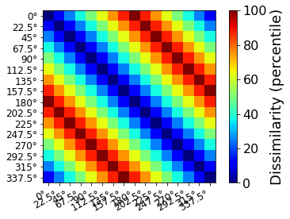
Representational Similarity Analysis
For EEG
16 orientations -> 16 conditions
The shape of RDM should be 16 * 16
Framework
Make hypothesis-based RDM
N_conditions * N_conditions
Make neural RDMs
N_subjects * N_timepoints * N_conditions * N_conditions
Compare between hypothesis-based RDM and neural RDMs
N_subjects * N_timepoints
A hypothesis-based orientation RDM:

Slide 21
Representational Similarity Analysis
Let’s go to the third example !
“Decode orientation representations” but using RSA

Slide 22
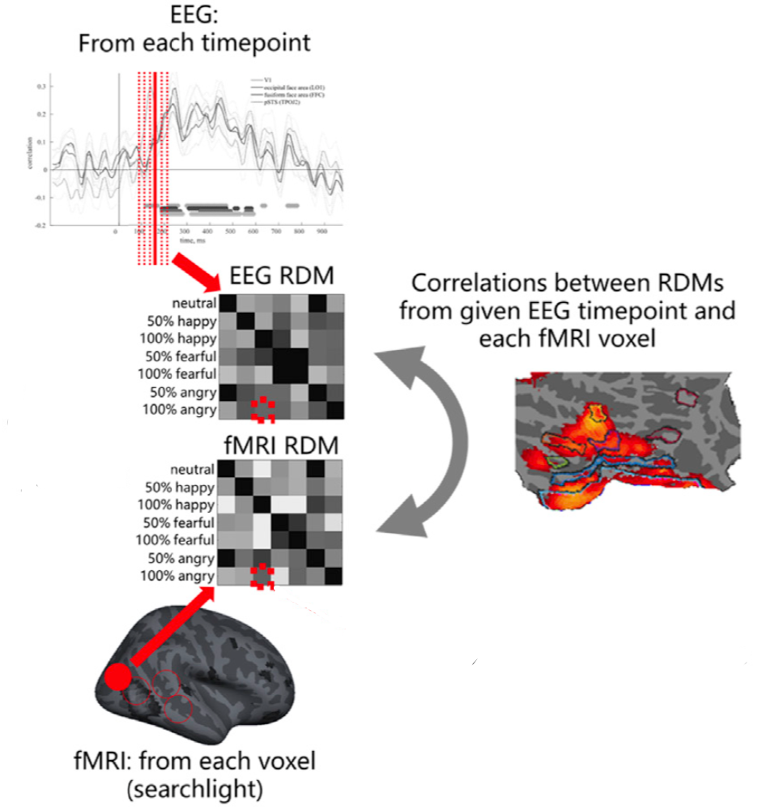
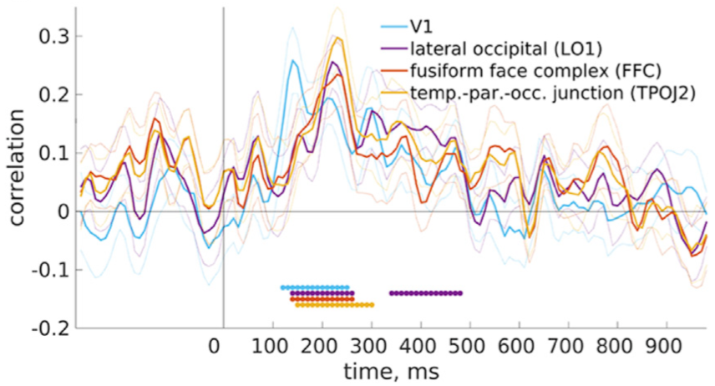
Representational Similarity Analysis
Some extensions:
fMRI-EEG fusion
(Muukkonen et al., 2020, NI)

Slide 23
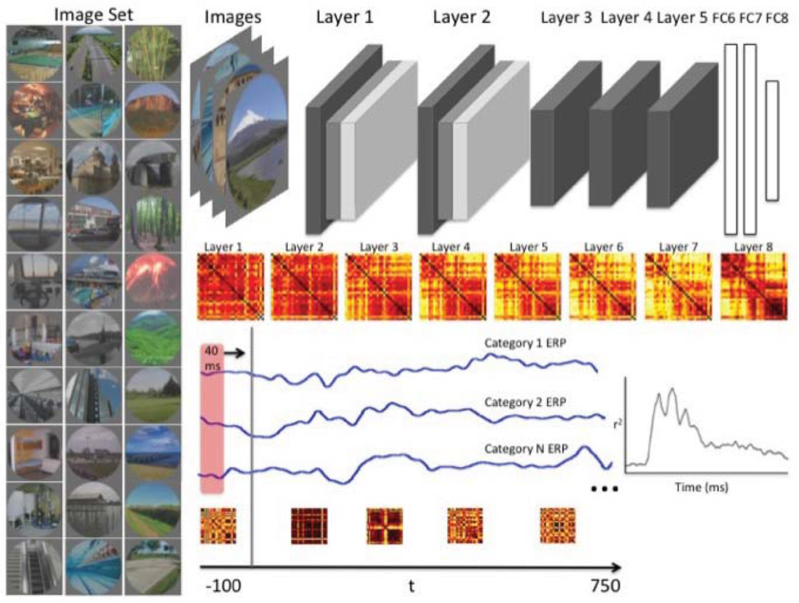
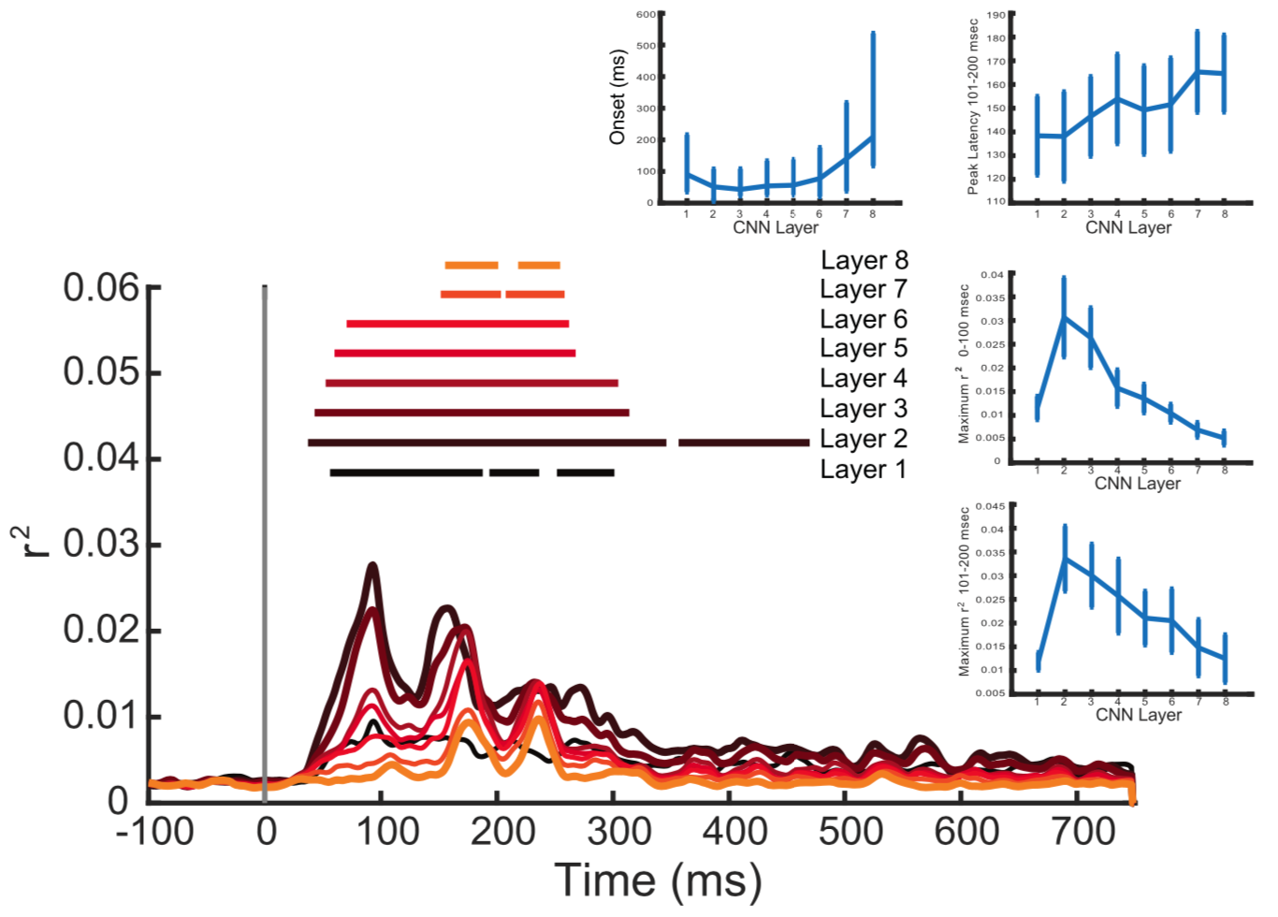
Representational Similarity Analysis
Some extensions:
Compare between brains and ANNs
(Greene and Hansen, 2018, Plos Comp Bio)

Slide 24
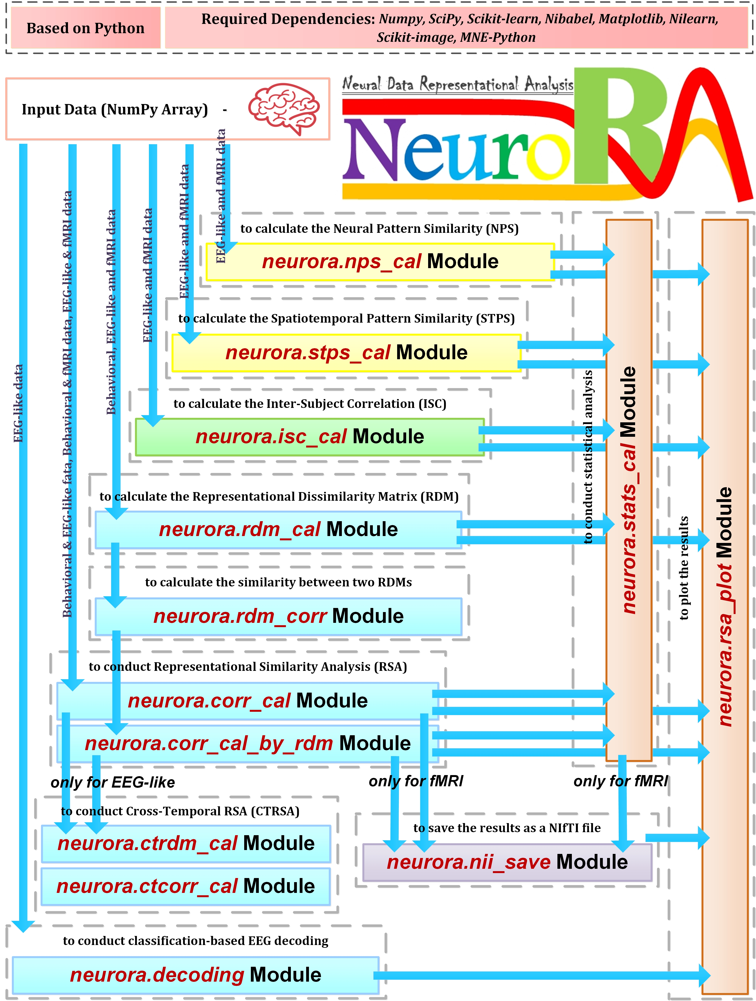
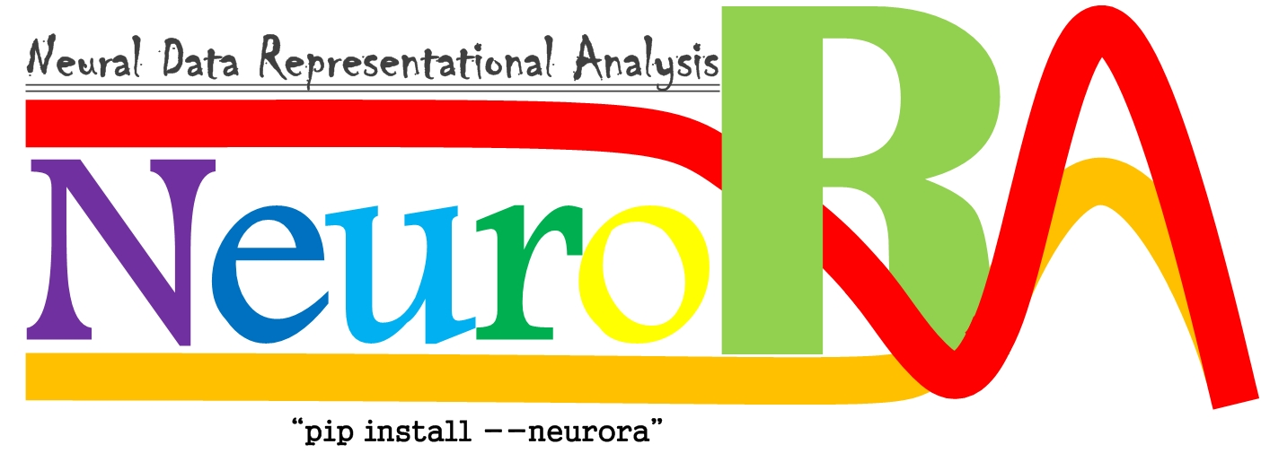
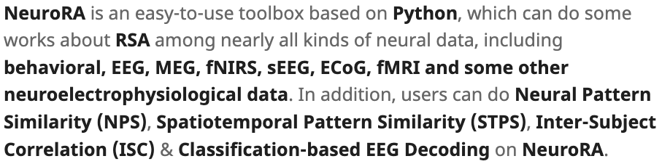
NeuroRA
https://zitonglu1996.github.io/NeuroRA/

Slide 25
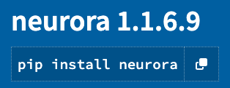
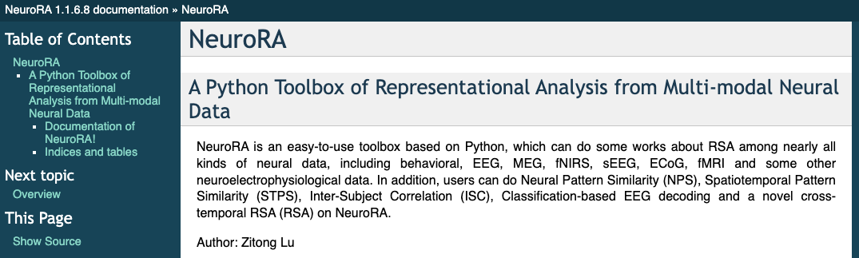
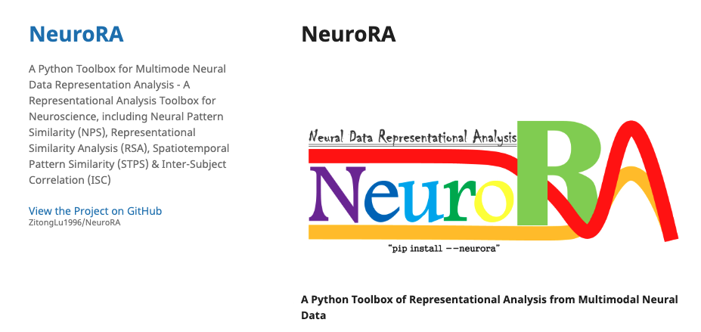
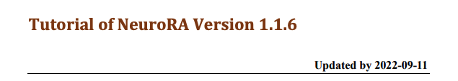
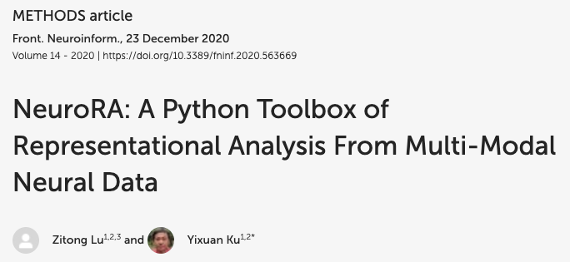
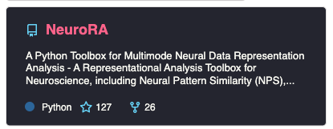
Thanks for coming!
Online documentation:
https://neurora.github.io/documentation/index.html
NeuroRA
Website:
https://zitonglu1996.github.io/NeuroRA/
Pdf documentation:
https://zitonglu1996.github.io/NeuroRA/neurora/Tutorial.pdf
GitHub:
Paper:
https://github.com/ZitongLu1996/NeuroRA

